Slide 1
Diplomatic Economic Club 2015
Issue 1

Slide 2
DEC – Issue 1
Agenda:
Snapshot - MIEPO in 2014
Moldova exports – strategy for a new impetus
What`s on our plate - partnership opportunities

Slide 3
Snapshot – MIEPO in 2014

Slide 4
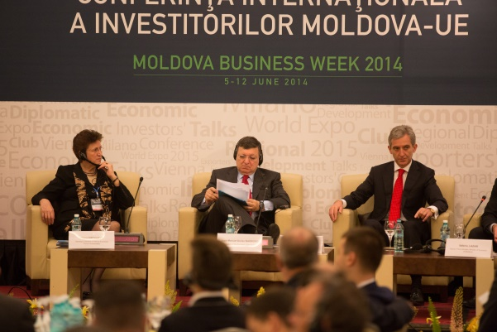
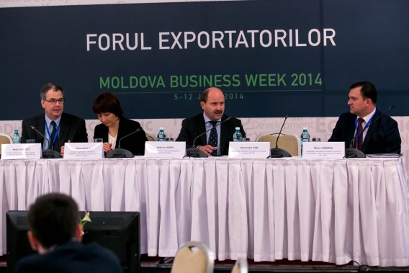

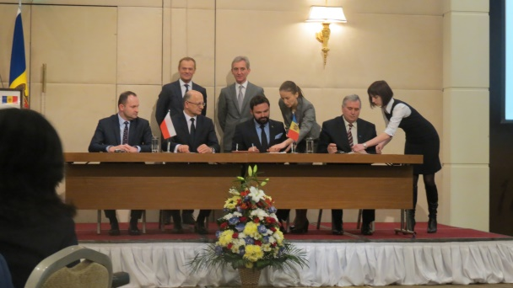
Snapshot – MIEPO in 2014
FDI Attraction – milestones of 2014:
High-rank investment missions to Moldova – 3 events
Exhibitions, fairs, missions – 15 events
Business Week (Vienna Economic Talks Chișinău, Moldova-EU Investment Forum)
Over 1000 participants in investment-related events in 2014
FDI Attraction related projects:
”Country brand communication strategy„
”Expo 2015” – preparation stage
”Investing Guide. Moldova 2014”
”Institutional capacity building & regional cooperation strategy”
”Industrial Parks development capacity building”
! The detailed 2014 activity report of MIEPO will be made available early March.

Slide 5

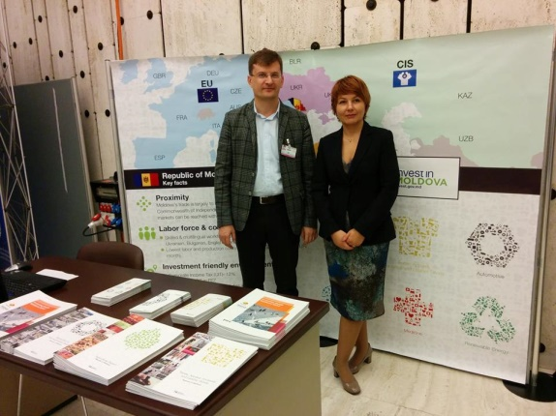

Snapshot – MIEPO in 2014
Export promotion – milestones of 2014:
1. Agrifood
7 fairs – 54 local producers benefitting of exposure
2 events ”Vernisajul Vinului” – 20 wineries
2. Textiles & apparel
5 fairs & exhibitions - 17 local producers involved
3. IT: Moldova ICT Summit 2014 – 1200 local & foreign visitors
4. Tourism
2 ”Cultural evenings” - 3200 foreigners acquianted with Moldova culture and wining traditions
5. Automotive: 6 fairs – 10 local producers participating
6. Furniture: 1 exhibition – 4 local producers involved
! The detailed 2014 activity report of MIEPO will be made available early March.

Slide 6
Moldova exports – strategy for a new impetus

Slide 7
Tools to promote Moldova exports
Diversification of export markets
Diversification of exported products
Education of a new-generation of export managers
MOLDOVA DOMESTIC EXPORT STRUCTURE (2013), %
MOLDOVA DOMESTIC EXPORT MARKETS (2013), %

Slide 8
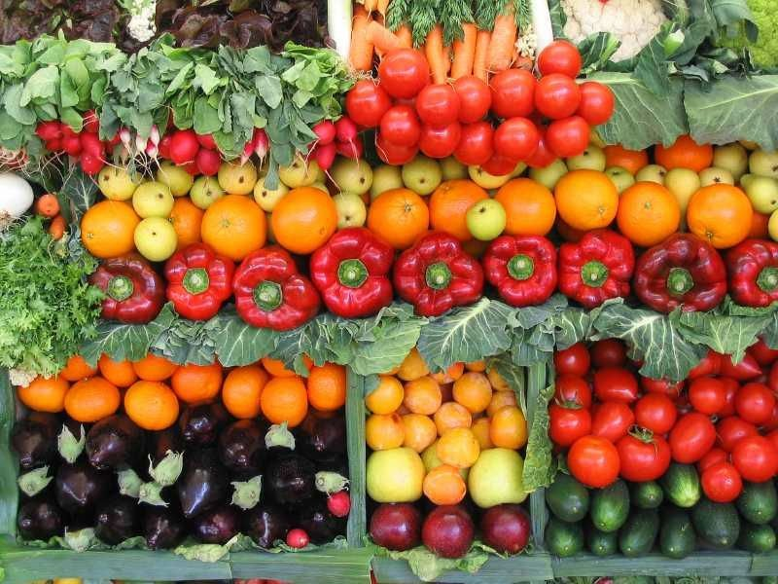
Vegetable products sector
VEGETABLE PRODUCT DOMESTIC EXPORT STRUCTURE (2013), %
COMPETITIVE ADVANTAGES | ISSUES
Excellent climate conditions; Diversified markets for nuts and seeds; International donor projects - production efficiency growth Actions taken to meet international food safety & quality standards (HACCP, ISO, EurepGAP); | Scarce post-harvest infrastructure; Dependence on traditional markets; No long-term sectorial strategy; Poor set of skills & competences of top management; Highly fragmented market;

Slide 9
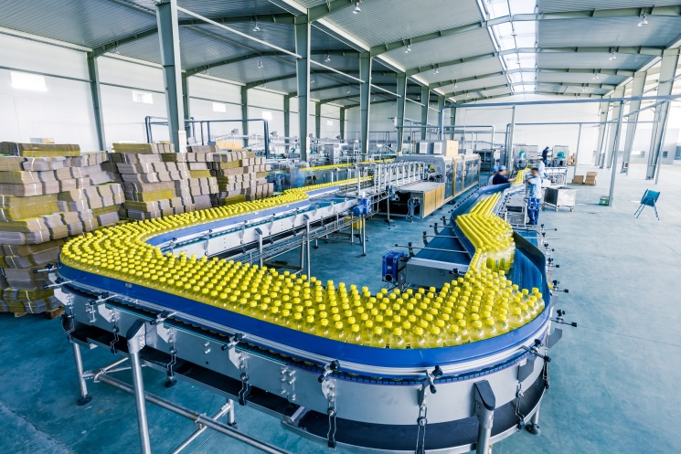
Food & beverage
FOODSTUFF & BEVERAGE DOMESTIC EXPORT STRUCTURE (2013), %
COMPETITIVE ADVANTAGES | ISSUES
Abundance of raw materials; Geo-economical location; Support from state and international donors (wine); | Insufficient support for other sub-sectors; Food safety, low adoption of EU standards;

Slide 10

Textile & apparel
TEXTILES DOMESTIC EXPORT STRUCTURE (2013), %
COMPETITIVE ADVANTAGES | PROBLEMATIC ISSUES
Skilled, competent labour force; Advantageous geographical location = flexibility and short delivery time. | Low added-value; Low remuneration & low scalability; Low uptake on technological transfer; Underdeveloped marketing and sales skills.

Slide 11
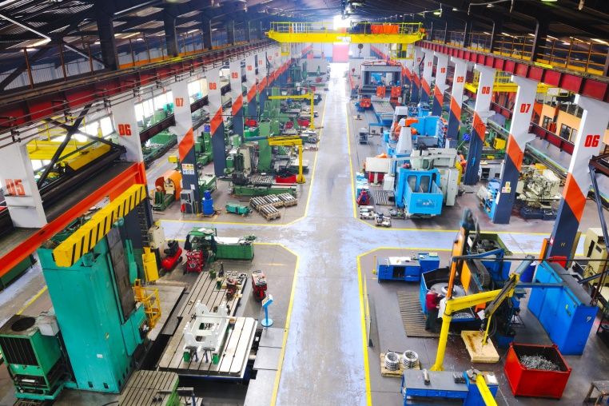
Manufacturing
DOMESTIC EXPORT STRUCTURE (2013), %
COMPETITIVE ADVANTAGES | PROBLEMATIC ISSUES
Low production costs; Strong traditions in machinery and electronics. | Obsolete infrastructure, technology & approach; Investment attraction questionable due to current regional political status.

Slide 12

BPO & IT
CURRENT SITUATION
ten-fold increase in exports over the last few years;
more than 500 companies in the industry, compared to 376 in 2003;
employment rate increase by 60% since mid-2000.
COMPETITIVE ADVANTAGES | PROBLEMATIC ISSUES
Low operational costs and skilled employees; Support from international donors and government; Tax advantages; Future - IT specialized technological park. | Education improvement and scalability; Lack of regulatory climate.

Slide 13
Focus of MIEPO
EXPORT ENHANCEMENT ASSISSTANCE
VEGETABLE PRODUCTS
PREPARED FOODSTUFFS
TEXTILES
INVESTMENT ATTRACTION
PREPARED FOODSTUFFS
MANUFACUTRING OF ELECTRONIC & MECHANICAL PRODUCTS
IT & BPO

Slide 14
Priority markets – Exports promotion

Slide 15
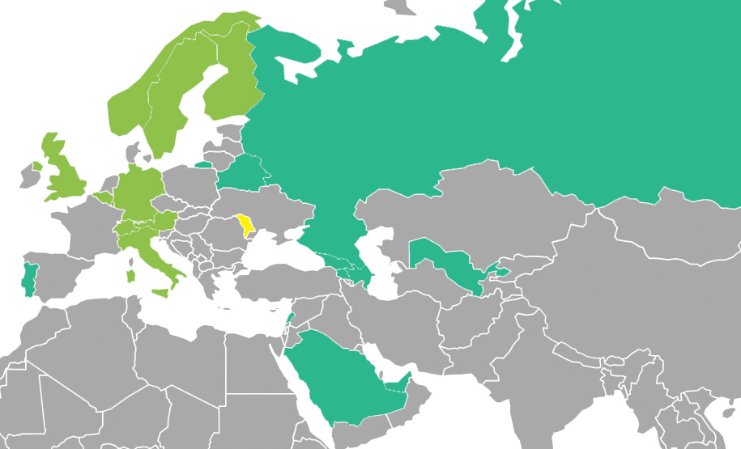
Priority markets – vegetable products
TOP 10 EXPORT MARKETS
TOP 11-20 EXPORT MARKETS

Slide 16
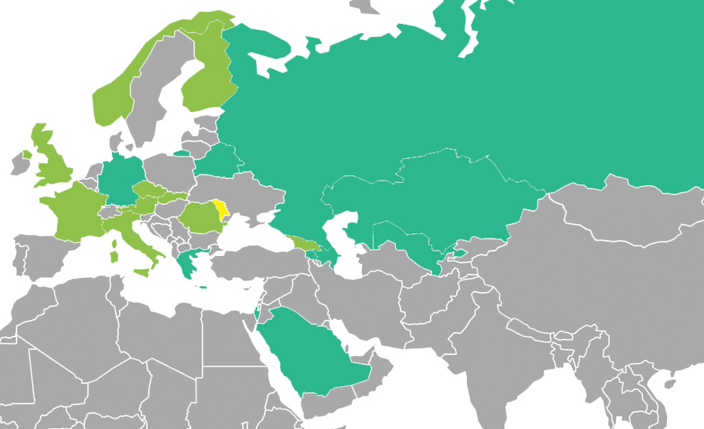
Priority markets – prepared foodstuffs
TOP 10 EXPORT MARKETS
TOP 11-20 EXPORT MARKETS

Slide 17
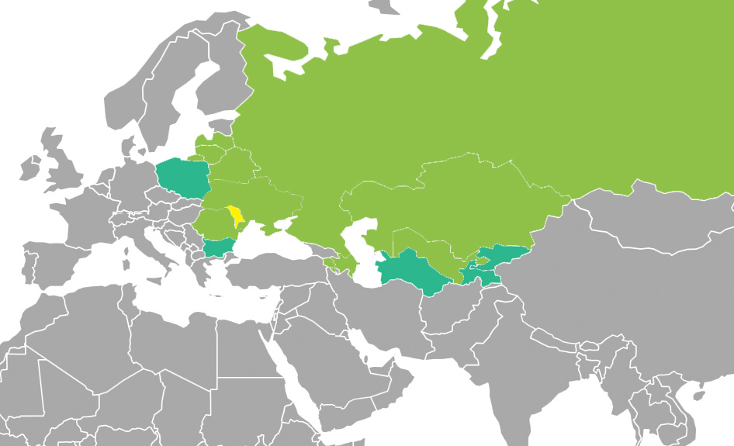
Priority markets – textiles
TOP 10 EXPORT MARKETS
TOP 11-15 EXPORT MARKETS

Slide 18
Priority markets – FDI attraction

Slide 19
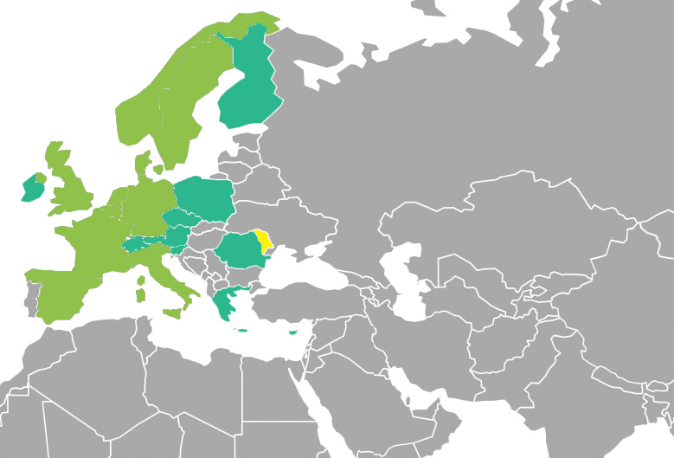
FDI attraction – prepared foodstuffs
TOP 10 MARKETS
TOP 11-20 MARKETS

Slide 20
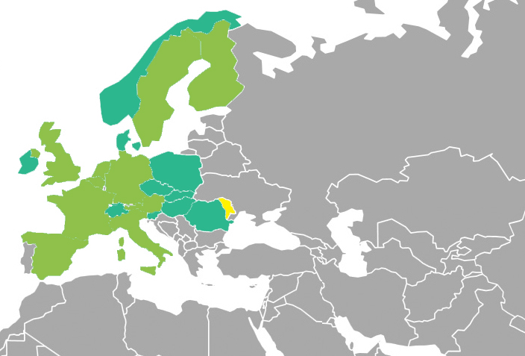
FDI attraction – manufacturing
TOP 10 MARKETS
TOP 11-20 MARKETS

Slide 21
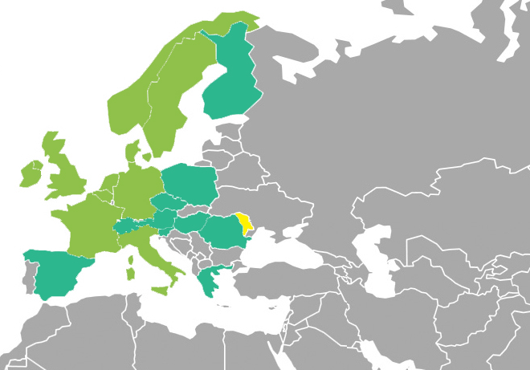
FDI attraction – IT & BPO
TOP 10 MARKETS
TOP 11-20 MARKETS

Slide 22
Projects and programs targeting export growth.
Partnership opportunities.

Slide 23
Overall export activity assessment
MARKET KNOWLEDGE & PLAN
EXPORT SKILLS & HUMAN RESOURCES
EXPORT PRODUCT
B2B MARKETING TOOLS
EXPORT SALES ACTIVITIES
EXPORT BUDGET
Small number of export ready products within key sectors.
Lack in human capital with international sales skills, presentation and foreign languages.
Lack of knowledge about target markets and insufficient market research activities
Weak marketing materials and lack of corporate marketing instruments (visuals, photos, texts);
Lack of targeted export promotion and proactive international sales
Donor project financed activities vs strategic Lack of funds for export promotion activities.

Slide 24
Approach to exporters` development
Education
Product development support
Study visits
Export manager
Corporate marketing development
Education about export processes and industry insights
Support export promotion activities
Promote as best exporters
Skills training for export managers
Not ready for export:
• No export record
• No website
• No export manager
• Product not up to international standard
• No export budget
Export close – One step to export:
• Corporate image in not develop to international standards
• No Export Manager with foreign languages
• Website is not in target market
• Small share of export
Export Ready
• Proven export
• Products in line with international standards
• Developed Corporate marketing
• Website in English
• Available export manager
• Export Plan & Strategy
Around 60% – 70%
Around 20% – 30%
Around 5% – 10%

Slide 25
Potential joint projects. ”Top Exporters”
Inspiration and ”can do” attitude of exporters
Why:
Motivate successful exporters
Inspire beginner-exporters
Shape Moldova country-brand as an exporting country
How:
Success stories rather than statistics
10 stories from exporters/experts
10 stories from the public/business environment
Public voting of most ambitious and outstanding success stories in export
Awarding during the Exporters Forum
Launch of the ”Flagman” hard-cover publication (succes-stories, nature treasures & monuments, representative products)
When:
June 2015 or September 2015, tbd

Slide 26
Potential joint projects. ”Exporters Academy”
10 modules over 20 weeks overall (Q3-Q4 of 2015-16)
Diverse topics covering but not limited to: international trade, trade regimes of different regions/countries, market research, forecasting, sourcing, packaging/storage/transportation options
Invited speakers & trainers
Format: trainings, seminars, workshops, team-play & tests
Open for current export managers and international trade decision-makers
Result: 15-20 next-generation export managers

Slide 27

Potential joint projects. ”Empretec”
Capacity building and support to private sector development
Why:
UNCTAD program, launched in 1988
Conducted in 34 countries for over 300,000 entrepreneurs
Creation of local, market-driven business support
Inspires entrepreneurial attitude
Expands business, creates jobs
Beneficiaries – starting entrepreneurs, women, small business, young people
How:
Series of soft-skills trainings
Conducted by trainers with vast entrepreneurial experience
Competitive format
Breaking stereotypes
When:
Autumn 2015, tbd

Slide 28
FDI attraction - ”Moldova Road-shows”
  Target market identification for each industry
  Proposition development – Why to invest in the specific sector?
  Preparation of Long list of companies from the target industry
  Invitation to an event – “Invest in Moldova”
  A seminar or a number of seminars in the target industry about possibilities in Moldova
  Individual meetings with target market companies
  Incoming visit organization to introduce potential investors
  Follow up of the visit and support in establishment in Moldova

Slide 29
Thank you!

